Slide 1

Apache HIVE
Image courtesy : https://en.wikipedia.org/wiki/Apache_Hive

Slide 2
Agenda
What is Apache HIVE
Why HIVE
How does HIVE fit into the Hadoop technology landscape
Limitations of HIVE

Slide 3
What is HIVE ?
HIVE is a query interface on top of Hadoop’s native Map-Reduce
HIVE is a data warehouse
HIVE allows users to write SQL style queries in a native language known as Hive Query Language (HQL)
HIVE execution engine converts the scripts written in HQL into JAR files (map reduce) to execute in the cluster
HIVE reads data from HDFS
Allows creation of tables to operate on structured data
The table’s schema information (table meta data) is saved in HIVE metastore which is borrowed from an RDBMS (Derby is default database)
HIVE is not an RDBMS

Slide 4
Why HIVE ?
Hadoop is known for its Map-Reduce engine for parallelizing data processing operations using HDFS as its native file storage system
Map Reduce does not provide user friendly libraries or interfaces to deal with unstructured data handling
Very tight dependency of JAVA if one needs to use the Map-Reduce framework
An operation like left inner join would need around 200-300 lines of code in JAVA Map-Reduce whereas in SQL it would just be a couple of lines of code
Analysts from SQL experience of having come from RDBMS world and DW/BI world cannot program in JAVA in order to use
To enable SQL developers to exploit the power of Hadoop, an abstraction interface was developed on top of native Map-Reduce
This interface (engine) was called HIVE and was officially developed by Facebook and initial release was in the year 2010

Slide 5
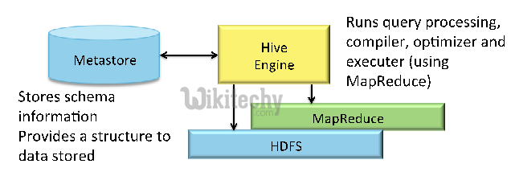
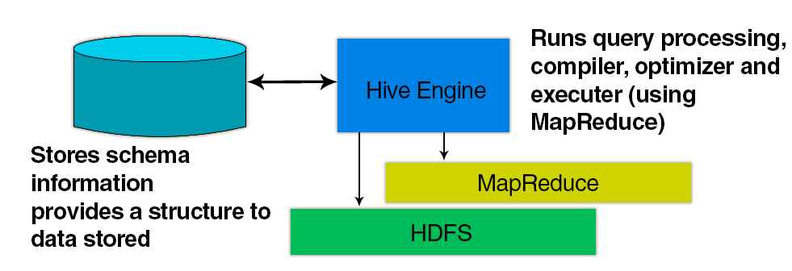
Architectural overview

Slide 6
Working of HIVE
Hive allows a way to project a table structure on the data in HDFS (structured data in HDFS)
The table meta data is saved separately from the data
In reality, we do not actually load the data into the place where HIVE tables are created
HIVE table information (table meta data is saved in meta store)
HIVE DATA
HIVE TABLE
HDFS
HDFS
HDFS
HDFS
METASTORE

Slide 7
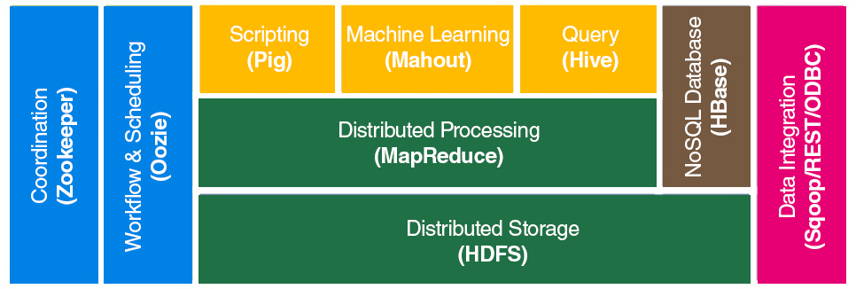
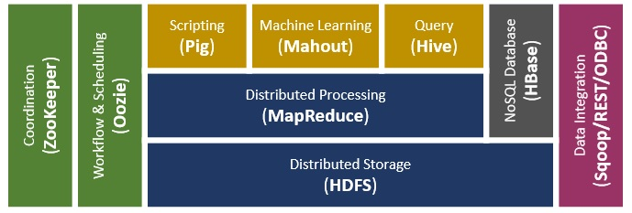
How does HIVE fit into the Hadoop ecosystem

Slide 8
Things HIVE cannot do efficiently
Ad hoc real time queries
OLTP (Online Line Transaction Processing)
No ACID support (ACID support is limited)
Not suited for frequent updates and inserts (inserts and updates are allowed in recent releases of HIVE)
Not recommended for small data sets
Not meant for unstructured data analysis

Slide 9
Hive supports several file formats
Text File.
SequenceFile.
RCFile.
Avro Files.
ORC Files.
Parquet.

Slide 10
RDBMS v/s HIVE
RDBMS | Hive
It is used to maintain database. | It is used to maintain data warehouse.
It uses SQL (Structured Query Language). | It uses HQL (Hive Query Language).
Schema is fixed in RDBMS. | Schema varies in it.
Normalized data is stored. | Normalized and de-normalized both type of data is stored.
Tables in rdms are sparse. | Table in hive are dense.
Size of data 10TB | Large size of data 100TB
It doesn’t support partitioning. | It supports automation partition.

Slide 11
DEMO

